Slide 1

Fundamental Data Structures in Python

Slide 2
Table of Content
Dictionaries
Numpy Arrays
Dataframes

Slide 3
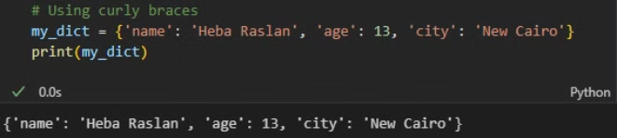
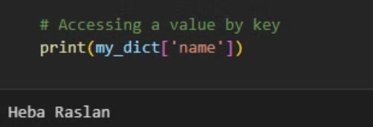
Dictionaries: Key-Value Pairs
Definition: A dictionary is a collection of key-value pairs.
Key Features
Creating Dictionary
Keys are unique and immutable.
Values can be of any type (int, string, list, etc.).
Dictionaries are unordered before Python 3.7 (OrderedDict in older versions).
Accessing Values
Dictionary Methods
keys(): Returns all the keys.
values(): Returns all the values.
items(): Returns key-value pairs as tuples.

Slide 4
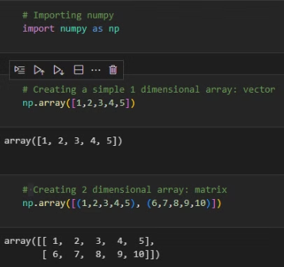
Numpy Arrays: Efficient Numerical Data
Definition: A NumPy array is a grid of values, all of the same type.
1
Key Features
2
Creating an Array
Supports multi-dimensional arrays.
Optimized for mathematical and numerical operations.
Faster and more efficient than Python lists.
3
Generating an Array
4
Data Selection
np.zeros((rows, columns))
arr[index] ➔ Access a specific element by index
np.ones((rows, columns))
arr[start:stop] ➔ Slice an array from index start to stop
np.arange(start, stop, step)
arr[start:stop:step] ➔ Slice with a step
np.linspace(start, stop, num)
arr[condition] ➔ Return elements where the condition is true
np.random.randint(low, high, size)

Slide 5
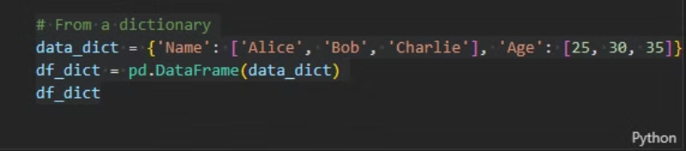
DataFrames: Tabular Data Organization
Pandas DataFrames are a powerful data structure for working with tabular data in Python. They provide a structured and efficient way to store and analyze data in a table-like format, with rows representing observations and columns representing features or variables.
1
Key Features
Each column can be of a different data type (e.g., integers, strings).
Supports operations on rows and columns.
Often used for data manipulation and analysis.
2
Creation of DataFrames
3
Viewing Data
df.head(n)➔View the first n rows (default is 5).
df.tail(n)➔View the last n rows.
​df.info()​➔Summary of the DataFrame (including data types).
df.describe()➔Generate descriptive statistics for numeric columns.

Slide 6
Choosing the Right Data Structure
Python provides a rich set of data structures, each with unique properties and use cases. Choosing the appropriate data structure depends on the specific needs of your application. Consider factors like the type of data, the required operations, and the importance of order, immutability, and uniqueness.
Lists
1
Use lists for ordered collections of data where you need to modify elements or iterate through them.
2
Dictionaries
Use dictionaries when you need to store data as key-value pairs for efficient retrieval based on keys.
NumPy Arrays
3
Use NumPy arrays for efficient storage and manipulation of numerical data, especially for mathematical operations and data analysis.
4
DataFrames
Use DataFrames for working with tabular data, providing a structured and efficient way to analyze and visualize data in a table-like format.
Sets
5
Use sets when you need to store unique elements, remove duplicates, or check membership efficiently.
6
Tuples
Use tuples when you need an immutable sequence to ensure data integrity or as keys in dictionaries.

Slide 7
What is Dask?
Dask is a flexible library for parallel computing in Python. It is designed to scale data analysis workflows from a single machine to a cluster of machines. Dask enables computations on large datasets that do not fit into memory by breaking them into smaller chunks and parallelizing operations. Dask is well-suited for tasks like:
1
Big data manipulation and analysis
2
Handling large arrays, dataframes, and machine learning computations
3
Parallelizing Python code on multiple cores or distributed systems

Slide 8
Dask DataFrame vs. Pandas DataFrame
Dask
Pandas
Works well with large datasets, distributed across multiple cores or machines.
Limited by memory on a single machine.
Supports parallel processing and distributed computing.
Runs on a single thread.
Slower for small datasets due to overhead of parallelization.
Faster for small datasets due to simple execution on one machine.
Reads data in chunks.
Loads entire data into memory.
Lazy execution (operations are delayed until explicitly computed).
Eager execution (operations are computed immediately).

Slide 9
Thank You

